Slide 1
HYDRAULICS & HYDRAULIC MACHINES

Slide 2
Unit 7: Centrifugal pumps

Slide 3
Learning Outcome
In this unit, you will learn
Components of centrifugal pump
Velocity triangles of centrifugal pump
Working principle of centrifugal pump
Single stage and multi stage centrifugal pump

Slide 4
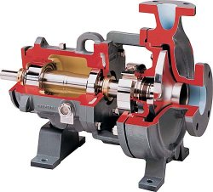
Centrifugal pumps

Slide 5
What is a pump?
A pump is a device for converting the mechanical energy into hydraulic energy.
Pumps enable a liquid to:
1. Flow from a region or low pressure to one of high pressure.
2. Flow from a low level to a higher level.
3. Flow at a faster rate.

Slide 6
Centrifugal Pumps:
Centrifugal pumps have a rotating impeller, also known as a blade, that is immersed in the liquid. Liquid enters the pump near the axis of the impeller, and the rotating impeller sweeps the liquid out toward the ends of the impeller blades at high pressure.
For low flows and high pressures, the action of the impeller is largely radial.

Slide 7
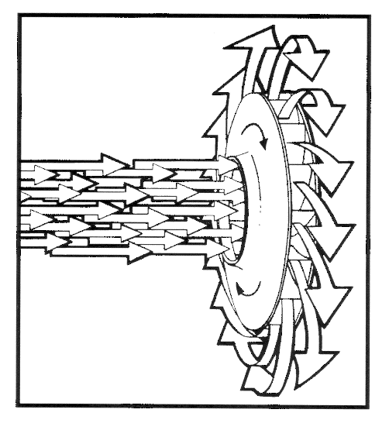
Working of a centrifugal Pump:
This machine consists of an IMPELLER rotating within a case (diffuser)
Liquid directed into the center of the rotating impeller is picked up by the impeller’s vanes and accelerated to a higher velocity by the rotation of the impeller and discharged by centrifugal force into the case (diffuser).

Slide 8
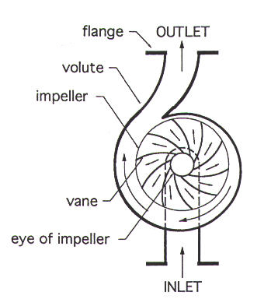
Centrifugal Pump
.
A collection chamber in the casing converts much of the Kinetic Energy into Head or Pressure.

Slide 9
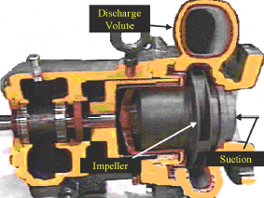
Components of a centrifugal pump
Impeller
Casing
Suction pipe (inlet)
Delivery pipe (outlet)
Volute
Impeller
Suction

Slide 10
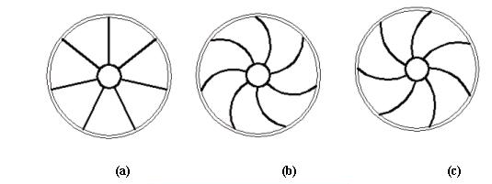
Impeller
There are three main categories of impeller due type of impeller’s vane, which are used in the centrifugal pumps as;
Radial vanes, Fig. (a).
Backward vanes, Fig. (b).
Forward vanes, Fig. (c).

Slide 11
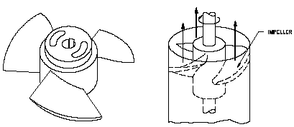
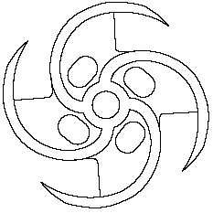
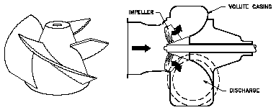
Impeller
Based on the type of impeller three main categories of centrifugal pumps exist
Axial flow
Radial flow
Mixed flow

Slide 12
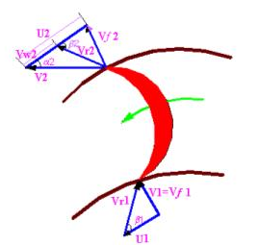
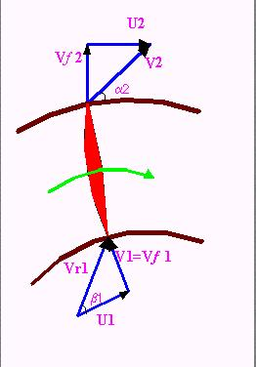
a) when β₂ > 90º, the Forwards curved vanes of the impeller.
b) when β₂ = 90º , the radial curved vanes of the impeller.
c) when β₂ < 90º, the Backwards curved vanes of the impeller.
where :
V = absolute velocity of the water.
U = Tangential velocity of impeller (peripheral velocity).
V_{r} = relative velocity of water to the wheel.
V_{f} = velocity flow.
N = Speed of impeller in (rpm).
13

Slide 13
Casing
Casing generally are two types:
I. Volute casings for a higher head.
A volute is a curved funnel increasing in area to the discharge port.
II. Circular casings for low head and high capacity.
have stationary diffusion vanes surrounding the impeller periphery that convert velocity energy to pressure energy.

Slide 14
Priming of a centrifugal pump
Priming is the process of filling the suction pipe, casing of the pump and the delivery pipe upto the delivery valve with the liquid to be pumped.
If priming is not done the pump cannot deliver the liquid due to the fact that the head generated by the Impeller will be in terms of meters of air which will be very small.
(because specific weight of air is very much smaller than that of water).
Priming of a centrifugal pump can be done by any one of the following methods:
i) Priming with suction/vacuum pump.
ii) Priming with a jet pump.
iii) Priming with separator.
iv) Automatic or self priming

Slide 15
Heads of a centrifugal pump
Head is a term for expressing feet of water column
Head can also be converted to pressure
Reservoir of Fluid
Head
Pressure
Gauge

Slide 16
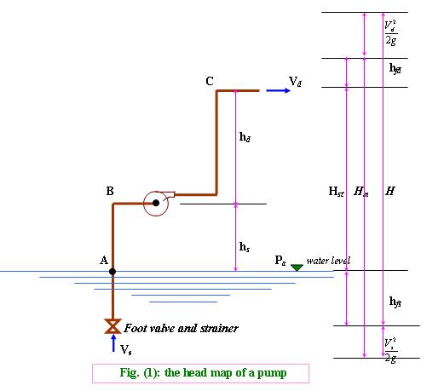
Heads of a centrifugal pump
V_{s} = Velocity of fluid in the suction pipe. V_{d} = Velocity of fluid in the delivery pipe. h_{s} = Suction head.
h_{d} = Delivery head.
h_{fs} = head losses in the suction pipe.
h_{fd} = head losses in the delivery pipe
Static head (H_{st})
H_{st} = h_{s} + h_{d}

Slide 17
Manometric head (H_{m}) :
but
and
(where
)
where h_{f} = h_{fs} + h_{fd}
(where H_{L} = impeller losses)
Total head (H)
When V_{s} = V_{d}
Hence H_{m} = H

Slide 18
Efficiencies of a centrifugal pump
1- Hydraulic Efficiency (ζ_{h})
The normal value varies between 60% - 90%
2- Manometric Efficiency(ζ_{m})
3 -Volumetric Efficiency (ζ_{v})
The normal value lies between 97% to 98%
14

Slide 19
4- Mechanical Efficiency (ζ)
It is due to losses in the shaft, coupling, and other operation losses as vibration
The normal value is 95% - 98%
5 - Overall Efficiency (ζ_{o})
Discharge of a Centrifugal Pump
The normal value is 71% - 86%
15

Slide 20
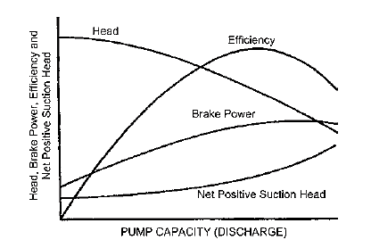
Characteristic curves of a centrifugal pump

Slide 21
Cavitation
Cavitation is defined as the phenomenon of formation of vapor bubbles of flowing liquid in a region where the pressure of the liquid falls below its vapor pressure and the sudden collapsing of this vapor bubbles in a region of higher pressure.
When the vapor bubbles collapse, a very high pressure is created. The formation and the collapse of a great number of bubbles on the surface produce intense local stresses that damage the surface by fatigue.
It may occur at the entry to pumps or at the exit from hydraulic turbines in the vicinity of the moving blades

Slide 22
Cavitation processes in centrifugal pump
The cavitation phenomenon develops in the impeller pump, when the pressure of liquid falls below the saturated vapor pressure at the prevailing temperature ( P_{s}< P_{v} of liquid), small vapor bubbles begin to form and the dissolved gases are evolved.
The vapor bubbles are caught up by the following liquid and swept into a region of higher pressure, where they condense. Condensation takes place violently, accompanied by a tremendous increase in pressure, which has the character of water hammer blows.
These impact follow each other in rapid succession, the vapor bubbles bursting both in the immediate vicinity of the surface attacked and in the pores causing cavitation pitting with many effecting.

Slide 23
Problems
1. A centrifugal pump running at 800 Rpm is working against a total head of 20.2 m. the external diameter of the impeller is 480mm and outlet width 60mm. If the valve angle at outlet is 40 and manometric efficiency is 70% determine
a)Absolute velocity of water leaving
b) Flow velocity at outlet The valve.
c) Angle made by the absolute velocity at outlet with the direction of motion at outlet.
d) Rate of flow through the pump
2. A centrifugal pump impeller having external and internal diameter 480mm and 240mm respectively is running at 100 Rpm. The rate of flow through the pump is 0.0576 m3/s and velocity of flow is constant and equal to 2.4m/s. the diameter of the section and delivery pipes are 180mm and 120mm respectively and section and delivery heads are 6.2m(abs) and 30.2m(abs) of water respectively. If the power required to drive the pump is 23.3KW and the outlet vane angle is 45 determine. a) inlet vane angle b) Overall efficiency c) manometric efficiency of the pump

Slide 24
Problems
3. It is required to deliver 0.048m3/s of water to a height of 24m through a 150mm diameter and 120m long pipe by a centrifugal pump. If the overall Efficiency of the pump is 75% and co efficient of friction f=0.01 for the pipe line. Find the power required to drive the pump.
4. The impeller of a centrifugal pump is of 300mm diameter and 50mm width at the periphery and has blades whose tip angle incline backwards 60 from the radius. The pump deliveries 17m3/min of water and the impeller rotates at 1000 Rpm. Assuming that the pump is design to admit radically. calculate
a)Speed and direction of water as it leaves the impeller
b)Torque exerted by the impeller on water c) Shaft power required
d) Lift of the pump.
Take mechanical efficiency=95% and hydraulic efficiency=75%

Slide 25
Questions
1.Explain the components of a centrifugal pump with a neat sketch
2. Explain the heads and efficiencies of a centrifugal pump
3. Explain the characteristic curves of centrifugal pump
4. What is meant by priming? Why is it important?
5. Explain the phenomenon of cavitation

